Slide 1
7 Sins in NYC
Chuan Sun
NYC Data Science Academy Bootcamp Project

Slide 2
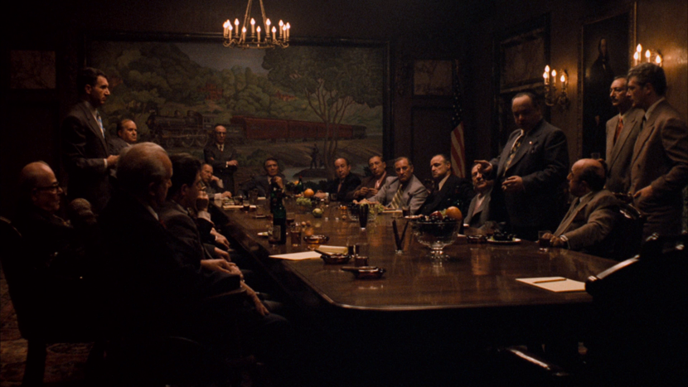

Slide 3
“One man’s wilderness is another man’s theme park.”
– By unknown

Slide 4
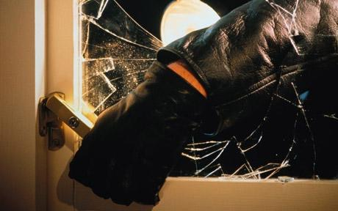


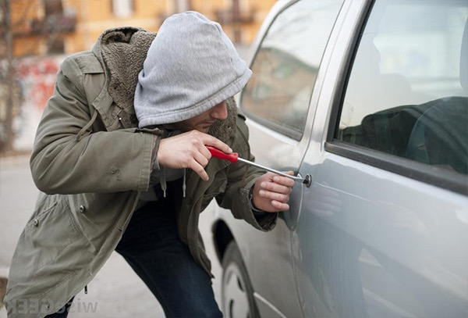
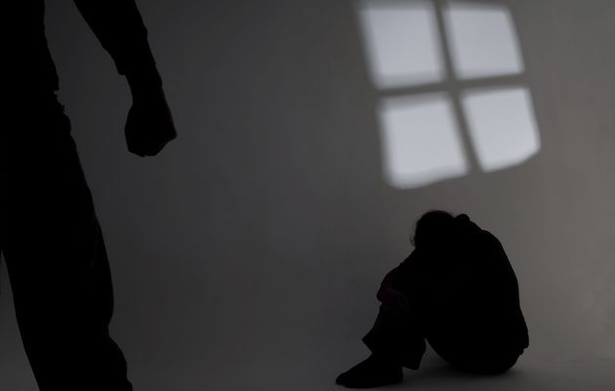

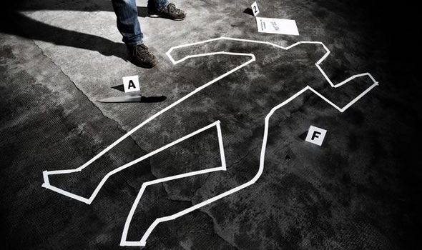
7 Sins
Burglary
Felony assault
Grand larceny
Grand larceny of motor vehicle
Rape
Robbery
Murder

Slide 5
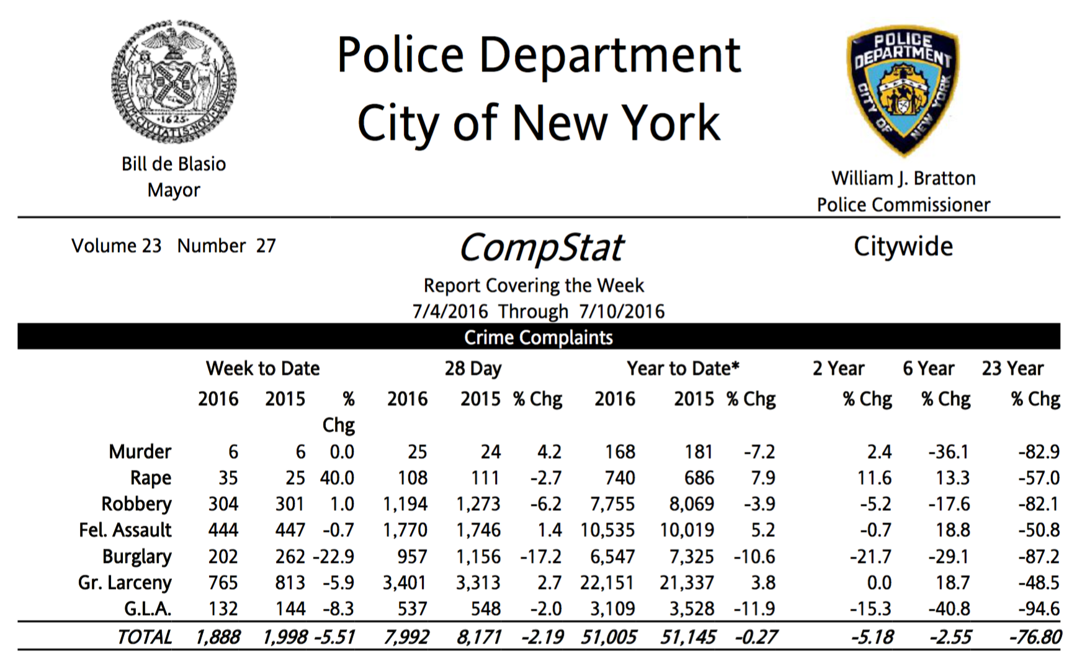

Slide 6
Questions
Is NYC becoming safer?
Which months of a year is safer?
Which days of a week is safer?
Which hours of a day is safer?

Slide 7

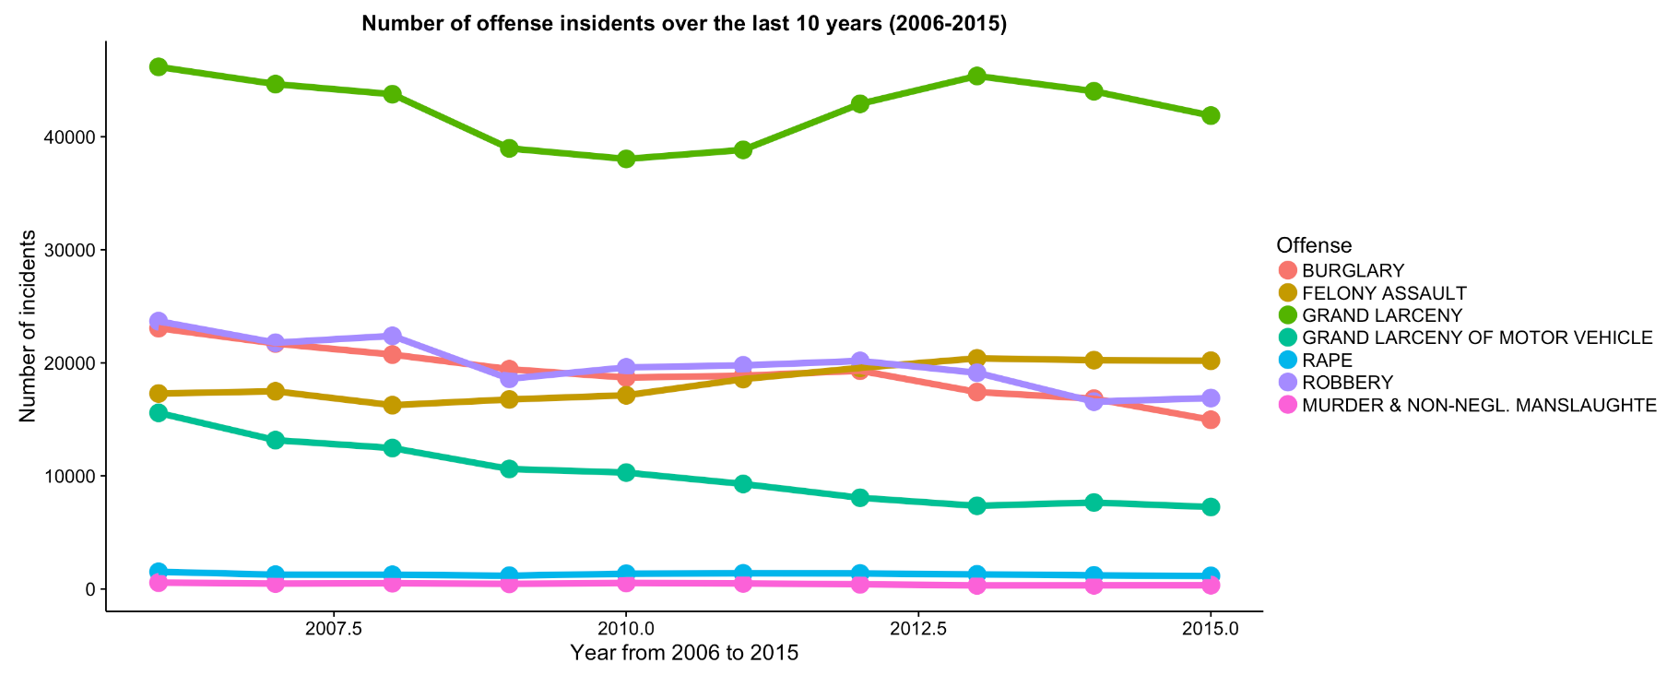


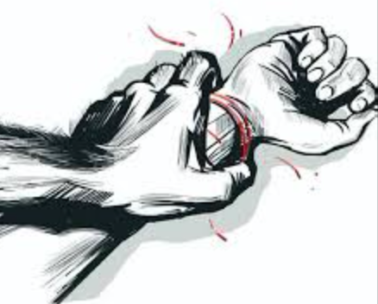


Trend in 10 years

Slide 8
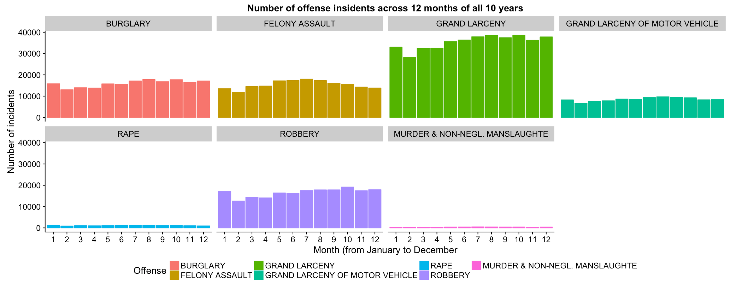
Incidents by month

Slide 9
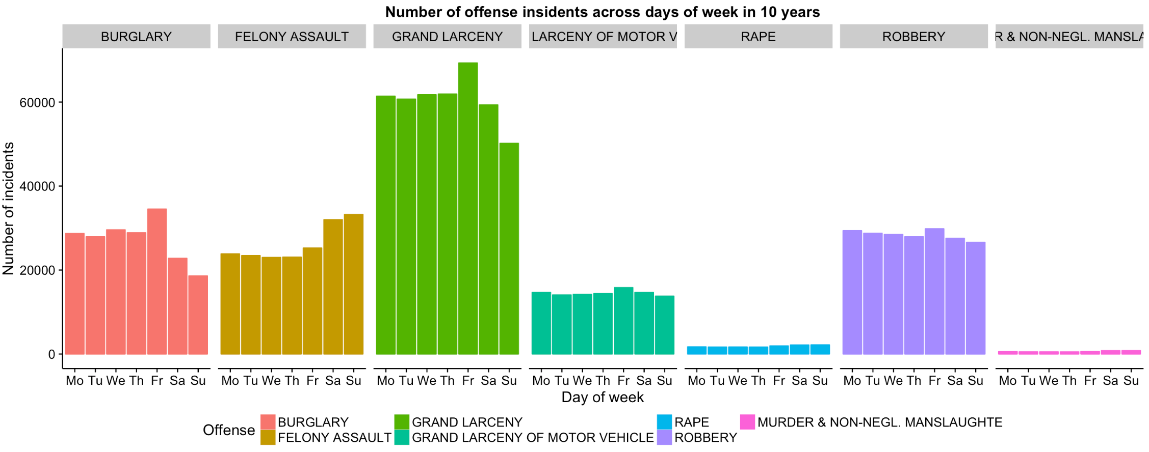
Incidents by day of week

Slide 10
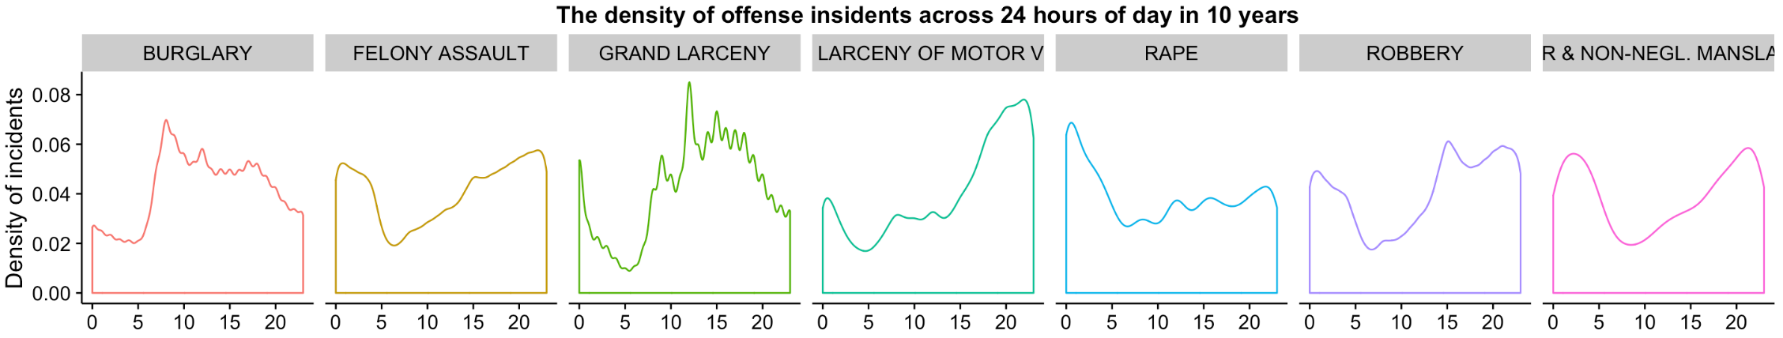
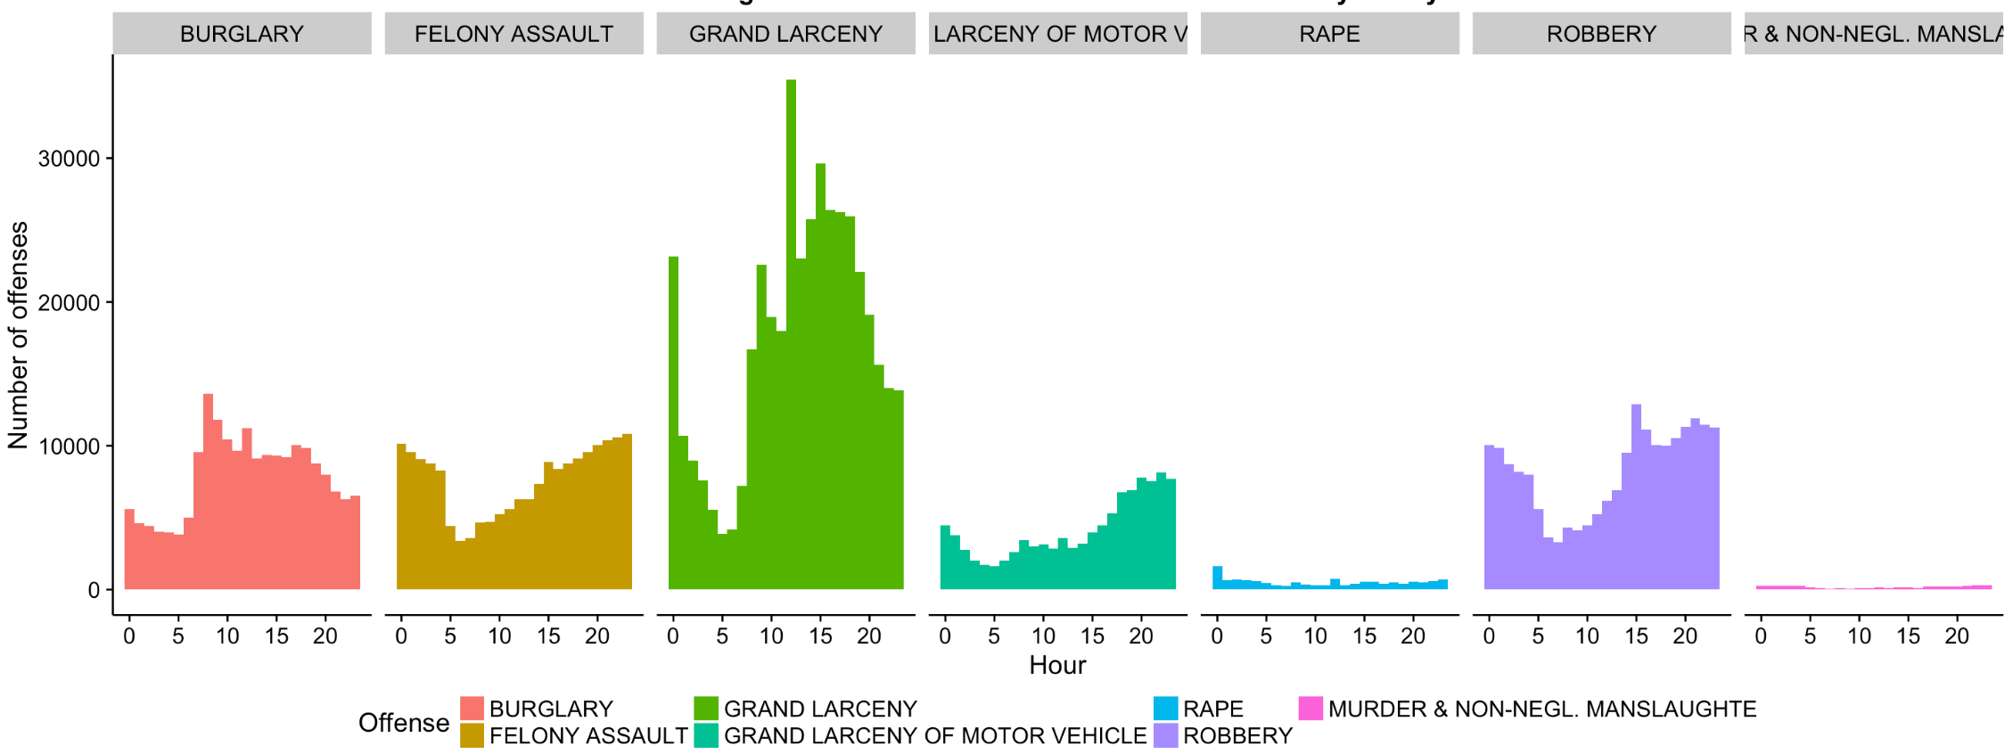
Incidents by hour
ff

Slide 11
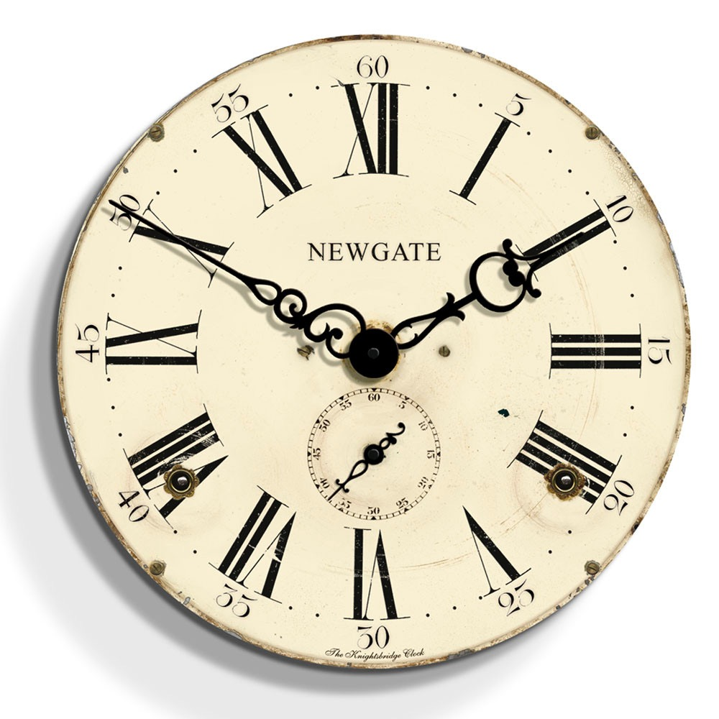
Middle night: 11pm-3am
Afternoon: 1pm-3pm
Morning: 7am-10am
Evening: 7pm-10pm

Slide 12

5am is perhaps the only safe hour!

Slide 13
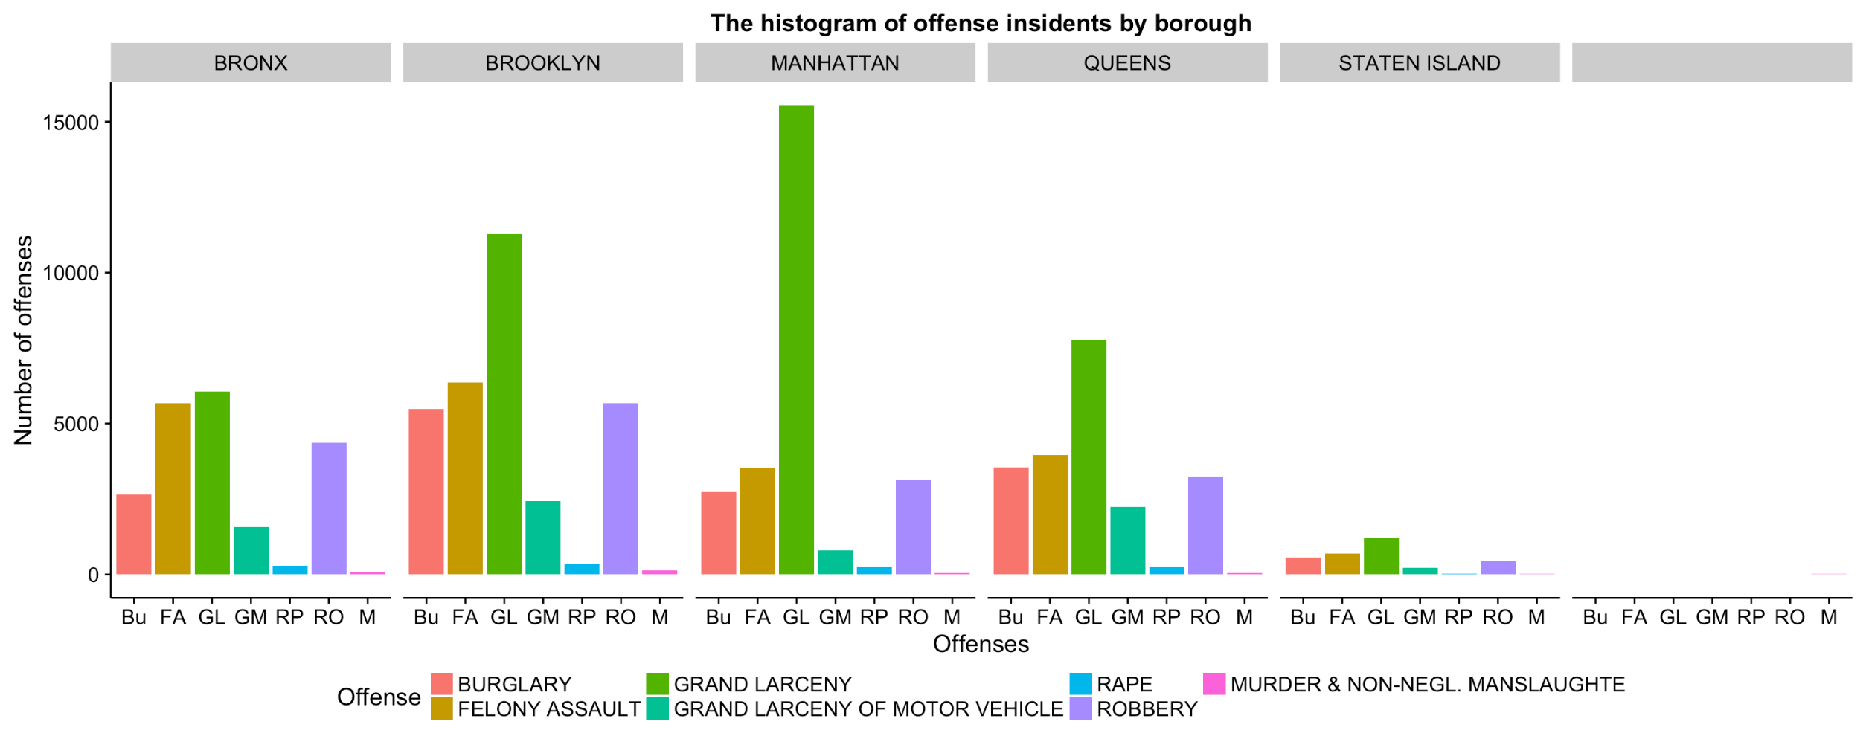
Incidents by borough

Slide 14
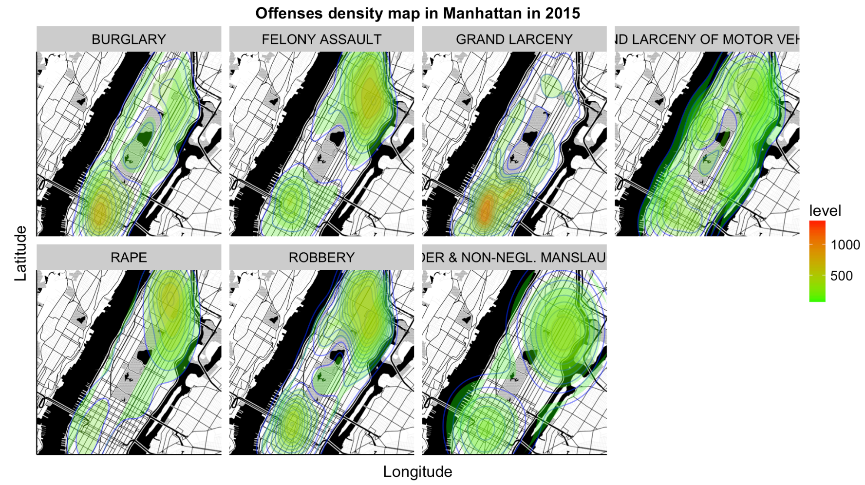
Offenses density map of Manhattan in 2015

Slide 15
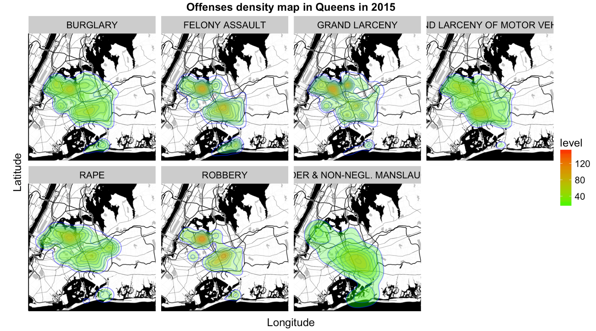
Offenses density map of Queens in 2015

Slide 16
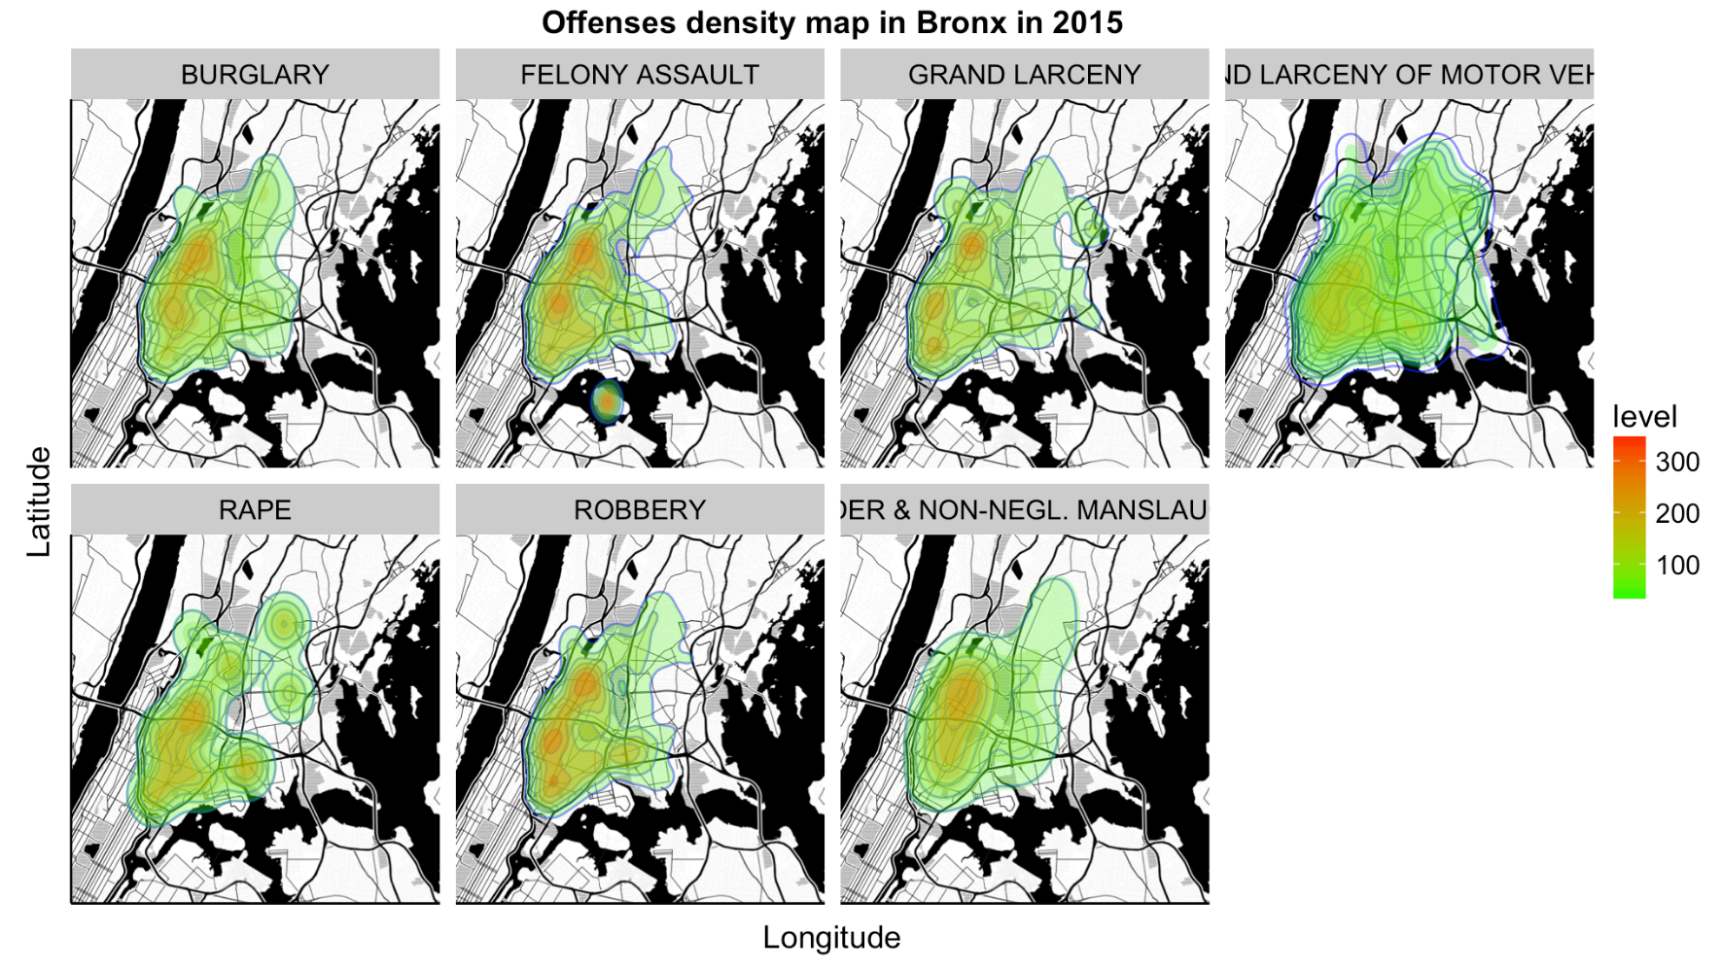
Offenses density map of Bronx in 2015

Slide 17
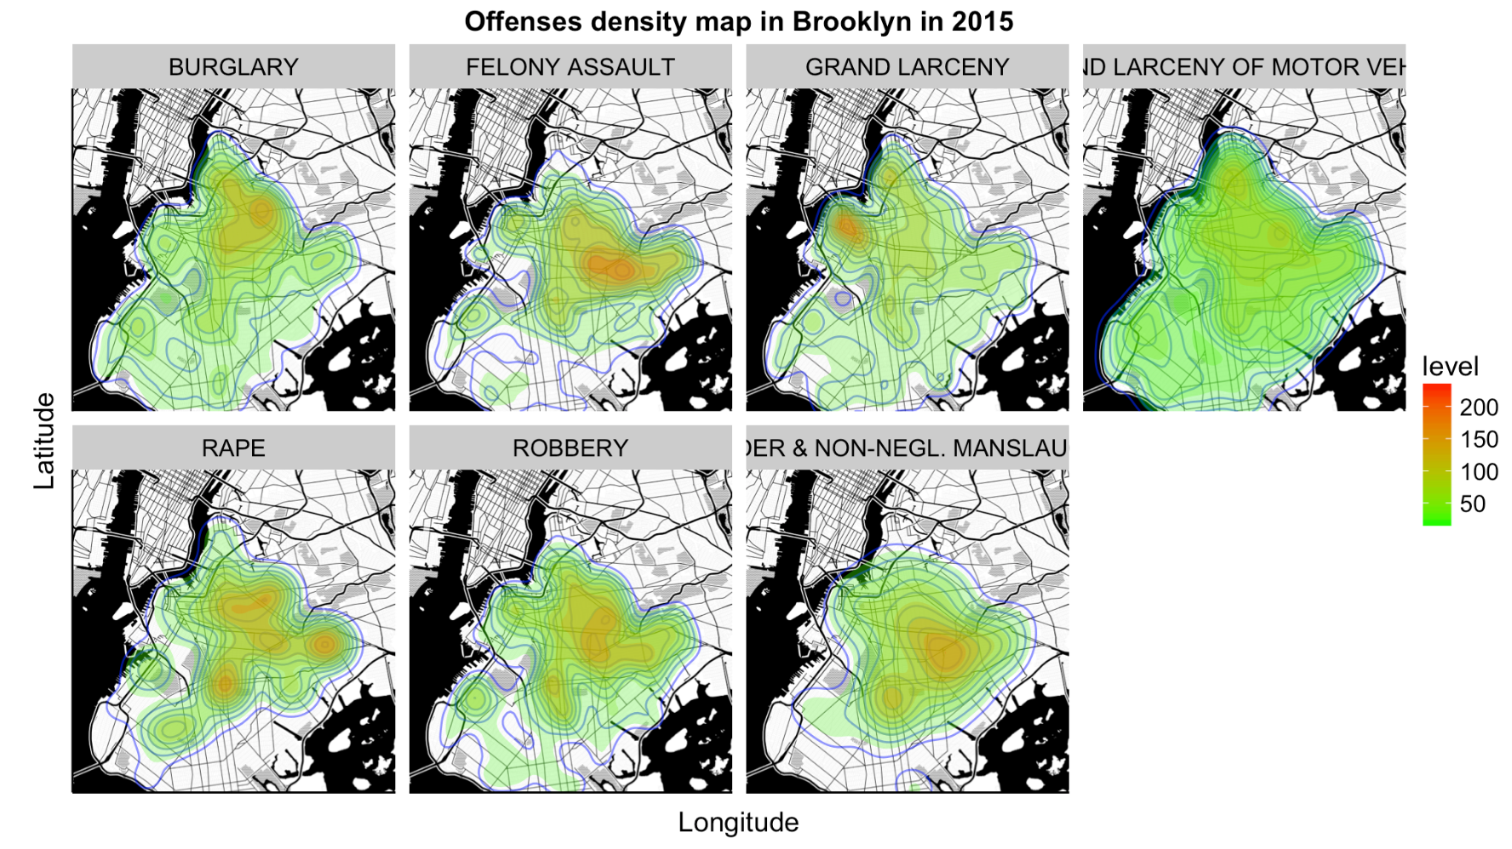
Offenses density map of Brooklyn in 2015

Slide 18
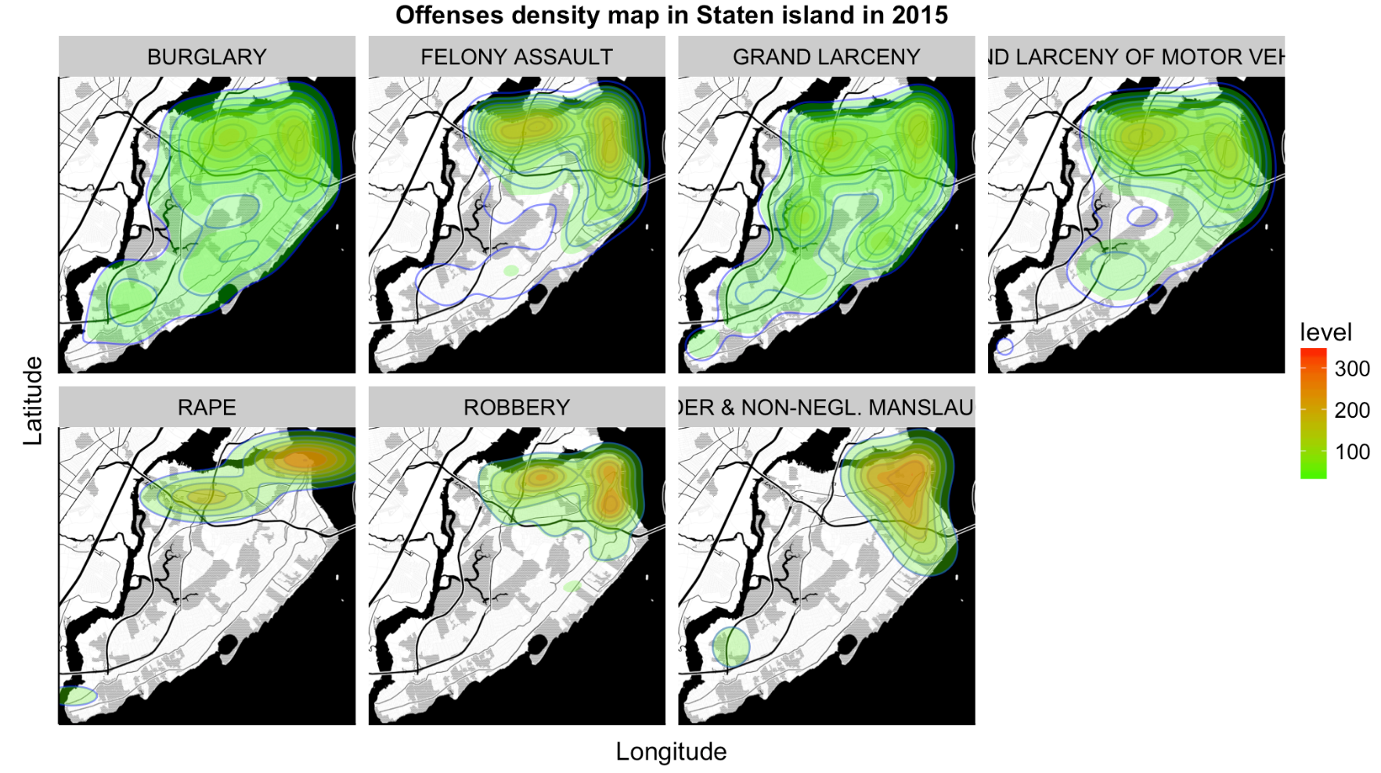
Offenses density map of Staten Island in 2015

Slide 19
Thanks!

